Slide 1
overview of solar panel recycling for Indigenous communities
Exploring the what’s, why’s and how’s of recycling in the solar industry
Alexis Glaudin
Graduate Summer Intern
Sandia National Laboratories, Albuquerque NM
Department 08924 Photovoltaics and Materials Technology
Presenting to Institute for Tribal Environmental Professionals, Critical Minerals Webinar
July 22, 2025
SAND2024-10169PE
Notes:
Hello, my name is Alexis Glaudin, and I will be talking about the research I conducted last summer at Sandia National Labs, where I sought to create a guide for tribal members to handling solar panels once they reach end-of-life status, and how solar panel recycling works as of today. For more information about options and solar recycling overall, I encourage you to read my SAND report, which I have sent the Institute for dissemination.

Slide 2






Alexis Glaudin, PhD Candidate
From York, Pennsylvania
B.S. Chemistry, UNC Chapel Hill (Spring 2021)
PhD Candidate, UW (Spring 2026)
Notes:
I am a rising fifth year graduate student at the University of Washington. I am Haitian and Irish on my dad’s side, and German and Lumbee Native American on my mom’s side. I grew up in York, Pennsylvania and went to UNC chapel hill for my undergraduate degree in chemistry. Then I moved to Seattle to get my PhD in chemistry.

Slide 3
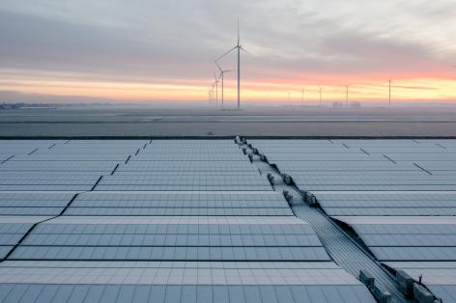
outline
Background & Motivation
Solar Panel Recycling Availability and Process
Pros and Cons of Current-Day Solar Recycling
Emerging Recycling Technologies
Conclusion
Stock photo
Notes:
Why do we care about solar recycling, what parts can be recycled, why should we consider solar recycling? What happens when a solar panel is recycled? Is it affordable?

Slide 4
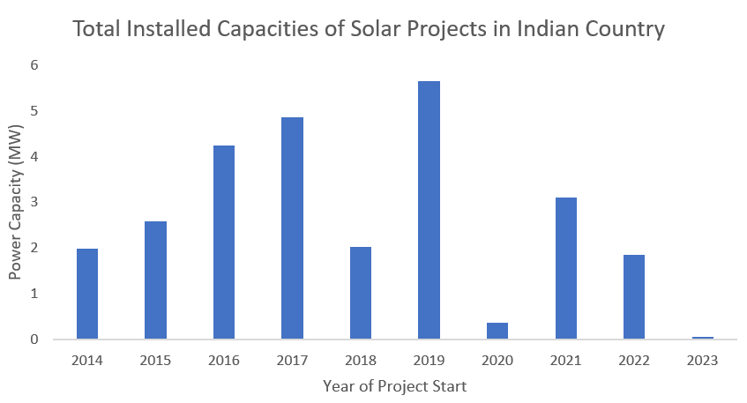
Doe-sponsored tribal solar energy is expanding
Data estimated from: Indian Energy Office website
Notes:
Explain what EOL is

Slide 5
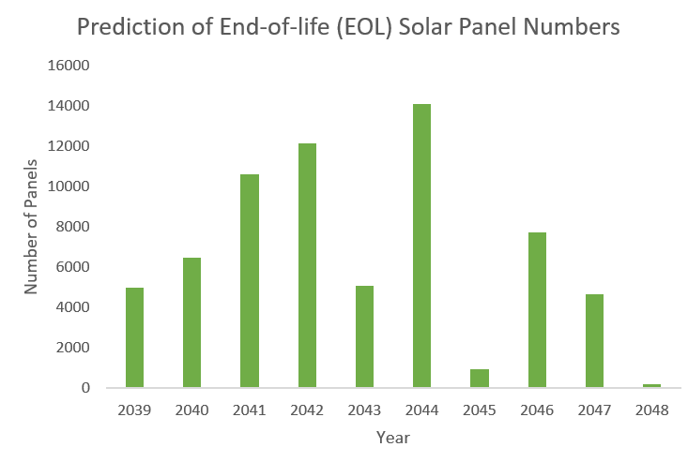
Managing solar panel waste is an imminent issue
Data estimated from: Indian Energy Office website
Notes:
Data collected from project reports on DOE website, data assumes efficiency of 1 panel=400 W, though more recent panels have higher efficiencies so some numbers are a bit of an overestimation

Slide 6
Managing solar panel waste is an imminent issue
5000 panels ≈ 100 tons of potential waste!
Data estimated from: Indian Energy Office website
Notes:
Data collected from project reports on DOE website. This is a lot of waste, so today’s talk will be about options that Native communities have for dealing with these panels

Slide 7
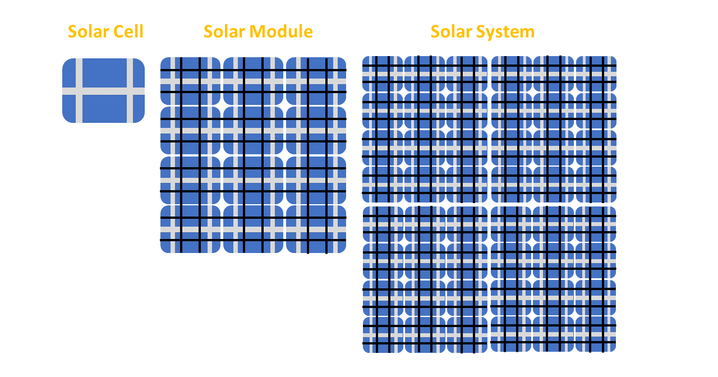
A Review of solar (Top-Down view)
A solar system is arranged like a beehive:
Solar Energy Technologies Office website
Sol. Energy Mater. Sol. Cells 2022, 248, 111976.

Slide 8
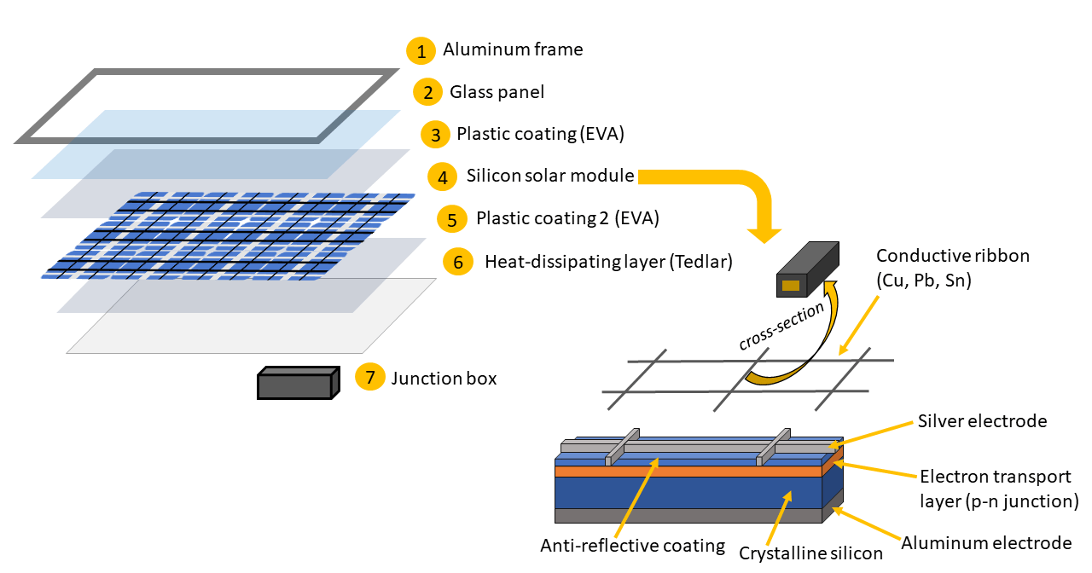
A review of solar (side view)
A solar panel is constructed like a sandwich:
Solar Energy Technologies Office website
Sol. Energy Mater. Sol. Cells 2022, 248, 111976.
Notes:
This diagram shows how silicon-based solar cells are made which represent 95 percent of the solar market, so I assume most if not all tribes are using silicon solar panels

Slide 9
An option for eol panels: recycling
The United States (US) currently does not have any federal regulations for handling end-of-life (EOL) solar panels. Today, tribes can make their own decisions for disposal . . .
Notes:
HOWEVER: if a tribe gets funding from the state, they have to follow state recycling regulations; when the federal govt puts a policy in place for regulations then the tribes will have to follow it (if they receive federal funding) It is worth noting that tribes do not have to throw out their panels as soon as they reach EOL. They can continue operating them or refurbish the entire array, but they will now work at a reduced efficiency and the module will continue to decline over time.

Slide 10
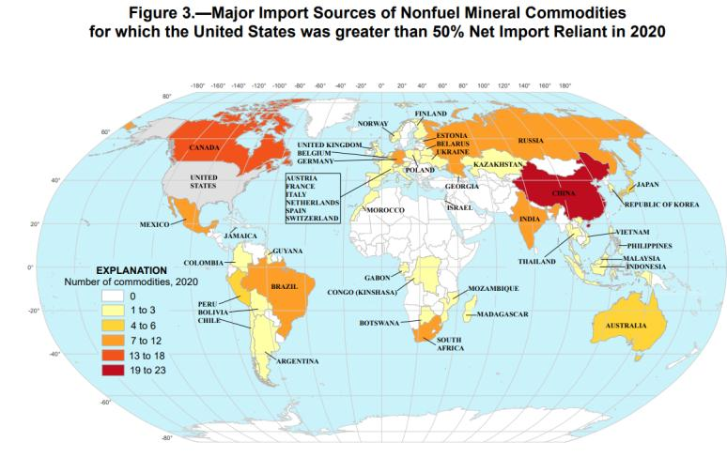
An option for eol panels: recycling
Solar panel manufacturing relies on import of metals from adversarial countries
Herring, R. Sandia National Laboratories, 2023, SAND2023-11056.
Notes:
This figure was used by former Sandia intern Rachel Herring who wrote a report on batteries for tribal use. Similar to

Slide 11
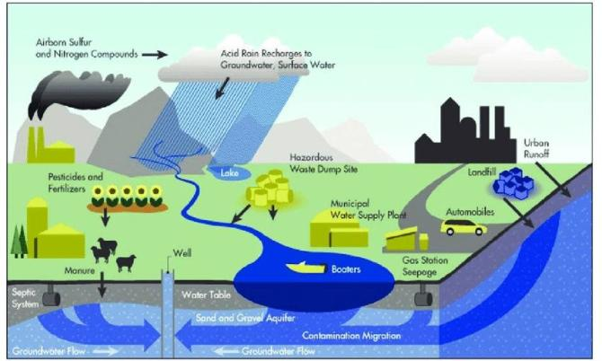
An option for eol panels: recycling
Dumping EOL panels in the landfill could lead to leaching of toxic and/or environmentally harmful metals, including cadmium, lead, chromium, and nickel
IOP Confer. Ser.: Earth Environ. Sci. 2020, 494, doi:10.1088/1755-1315/494/1/012013.
Notes:
As a result of this, there are hazardous waste regulations that must be followed before dumping panels in the landfill or recycling them.

Slide 12
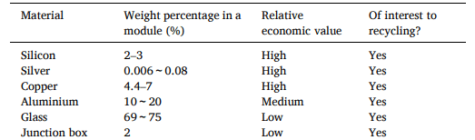
An option for eol panels: recycling
Most materials in a solar panel are readily recyclable:
Sol. Energy Mat. Sol. Cells. 2022, 248, 111976.
Notes:
Materials in solar have inherent economic value.

Slide 13

Many companies nationwide are capitalizing on solar recycling
3
1
2
1
1
2
2
1
1
1
4
1
2
4
3
1
3
7
2

Slide 14




Many companies nationwide are capitalizing on solar recycling
3
1
2
1
1
2
2
1
Most prolific solar recycling companies:
1. Electronic Recyclers International (9 states)
2. Interco (9 states)
3. We Recycle Solar (9 states)
4. FabTech Enterprises (7 states)
1
1
4
1
2
4
3
1
3
7
2

Slide 15
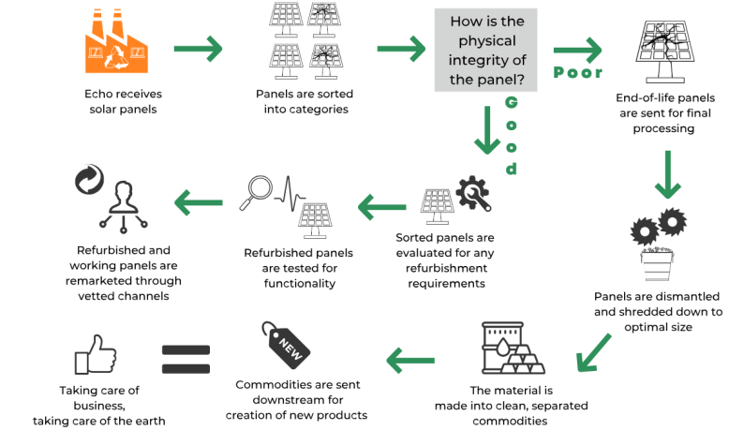
What is the process for recycling solar panels?
Echo Environmental website
Notes:
FOR EXAMPLE, ECHO ENVIRONMENTAL PROCESS This process is specific to the company Echo Environmental, other companies may have slightly different processes

Slide 16
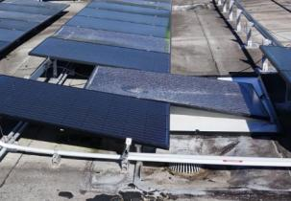
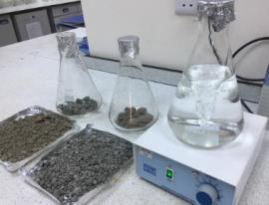
constraints for solar panel recycling
1. Hazardous Waste Regulations
  Damaged solar panels can expose recyclers to toxic metals, which can result in serious health problems
  To mitigate this risk, all damaged panels must be tested for exposed toxic, leachable metals using the Toxicity Characteristic Leaching Procedure (TCLP)
    If the test shows leachable toxic metal levels are above the allowed threshold, those damaged panels cannot be recycled
  Consult with a hazardous waste professional to determine the number of non-recyclable solar panels in your solar array
EPA website
End-of-life Solar Panels: Regulations and Management. Environmental Protection Agency, 2023. Accessed 20 Aug 2024.
Caspian Environmental Laboratory website
Notes:
There are some factors that have to be considered by the tribal community when dealing with end of life panels

Slide 17
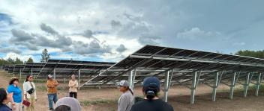
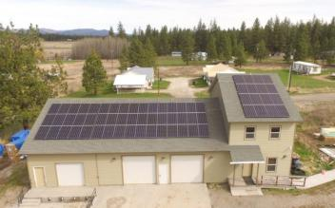
constraints for solar panel recycling
2. Limitations on solar recycling (minimums)
  Some companies only recycle utility-scale panels (i.e. We Recycle Solar)
  Other companies place have wattage/weight minimums
    SolarCycle: 500 panel minimum (~200 kW solar capacity)
    First America: 5,000 lbs minimum (~125 panels or 50 kW solar capacity)
Field visit to Picuris Pueblo
Children of the Sun solar initiative
Notes:
These are some things to consider when choosing a solar panel recycling service. The solar capacity equivalencies are based on a 400 W minimum per panel

Slide 18


constraints for solar panel recycling
3. Price of recycling
  Recycling costs money, BUT selling panels suitable for reuse gives you a discount
damaged/unusable panels: $0.15-$0.45/lb
panels suitable for reuse: sold for $0.05/W
damaged/unusable panels: $0.30-$0.60/W
panels in good condition: $0.08-$0.12/W
Notes:
Though refurbished/reused solar panels may not be suitable for tribal utility use, they can be sold to people living off-grid for their RVs, for pumps, farms, and replacement panels

Slide 19
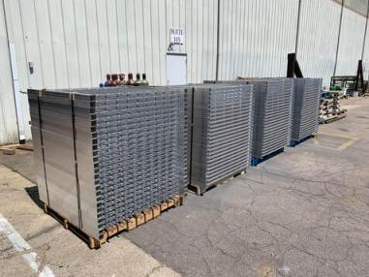
constraints for solar panel recycling
4. Extra costs
  Most companies will charge for panel palletizing, loading, and shipping
    Save money by dismounting and palletizing panels yourself
    Find a company located close to you to minimize shipping costs
Stock photo

Slide 20
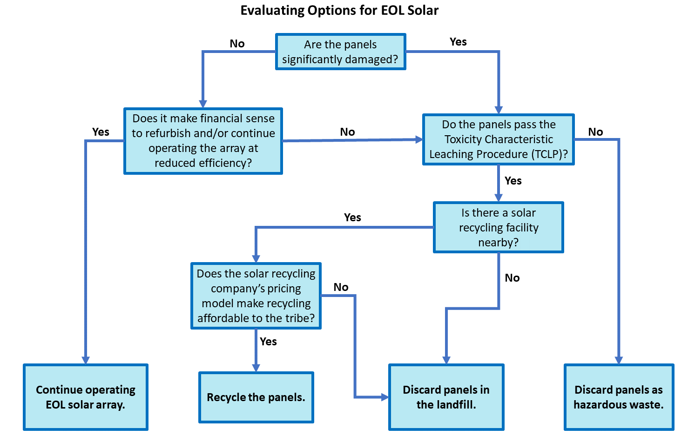
Notes:
This flowchart is not intended as an advising tool, but rather a educational one that illustrates how complex it can be evaluating options for eol solar

Slide 21

current solar panel recycling methods are unsustainable and hazardous
Thermal Delamination
Uses heat in the absence of oxygen to remove the polymer and backsheet layers
  Called pyrolysis
  Requires a lot of energy
  Requires 2 phases of 15-minute heating sessions per batch
Sol. Energy Mat. Sol. Cells. 2022, 248, 111976.
J. Cleaner Production. 2023, 415, 137908.
Notes:
Even though solar recycling is widely available and relatively cost-effective, there are some problems with the way solar panels are currently recycled….

Slide 22




current solar panel recycling methods are unsustainable and hazardous
Chemical delamination (chemical swelling)
An alternative to pyrolysis, can remove polymer and backsheet layers by dissolving them in solvents:
  Toluene
  Hexane
  Environmentally friendly alternative: ethanol/potassium hydroxide
Sol. Energy Mat. Sol. Cells. 2022, 248, 111976.
Notes:
Ethanol is flammable and bad for health in large quantities, but less harmful and the potassium hydroxide can be neutralized, reducing environmental hazards

Slide 23



current solar panel recycling methods are unsustainable and hazardous
Chemical etching and hydrometallurgy
Chemical etching is used to recover pure silicon
  hydrofluoric acid, nitric acid, and sodium hydroxide are required to achieve 90% recovery
Hydrometallurgy is used to recover silver ions
  uses nitric acid, sodium chloride, hydrochloric acid, and sodium hydroxide
Sol. Energy Mat. Sol. Cells. 2022, 248, 111976.
Notes:
Most recycling companies claim to recover 80-95% materials from solar panels so using these harmful chemicals is necessary to stay competitive
Nitric acid is corrosive, oxidizer, and toxic; HF is corrosive, toxic;

Slide 24
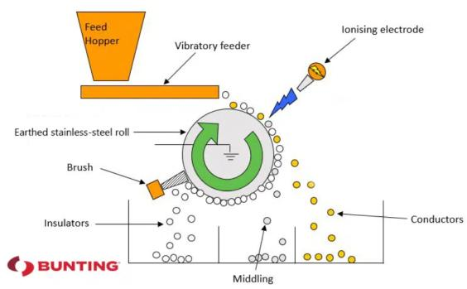
Emerging eco-friendly recycling methods
Electrostatic separation
Technique used in electronics recycling
Already used by some solar recycling companies
Separates materials based on conductivity
J. Cleaner Production. 2023, 415, 137908.
Notes:
Electrostatic separation: material is crushed to size of 1 mm-500 microns, there is an electrode (corona discharge system); materials w higher conductivity get discharged faster by the corona; the discharge induces an electrostatic force equal and opposite to the centrifugal force, causing the higher conductivity metals to fly off first; less conductive material is not flung off and falls in a different container
PROS: requires minimal energy, does not output pollution
CONS: requires some adjustments of the roll speed and corona voltage to optimize separation; the cannot separate polymer film from the materials in the solar module, so harsh chemicals are still needed to remove that

Slide 25


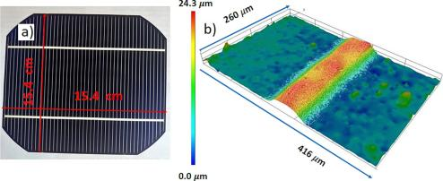
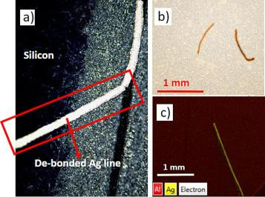
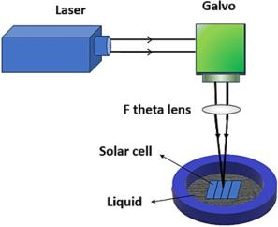
Emerging eco-friendly recycling methods
Laser debonding
Laser radiation is a localized heat source
Materials are melted and separated based on differences in thermal expansion
  In this paper: Silicon (Si), silver (Ag)
Process can be automated
Prof. Mool Gupta
Solar Energy. 2024, 270(1), 112381.
Notes:
PROS: use of laser allows for precise work (35 microns), could be modified to separate several components of a silicon cell
CONS: is not expensive over time, but requires an up-front purchase of the laser itself.
Descibe the images

Slide 26

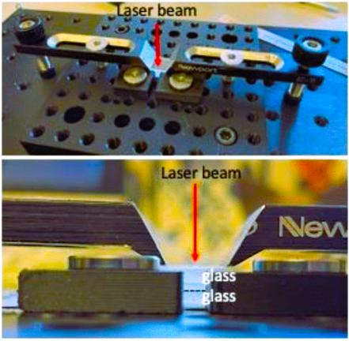
Emerging eco-friendly recycling methods
Laser welding for glass/glass solar modules
Eliminates the need for polymer encapsulant
  → the hazardous procedures required to remove polymers in solar panels become obsolete
Preliminary results show glass/glass welding provides better environmental protection for the module and enhanced insulation from heat
Next Steps: apply laser welding to full-scale solar module
Young, D. L.; Silverman, T. J.; et al. IEEE J-PV 2024, 14(3), 497-502.
Notes:
The previously mentioned eco-friendly methods do not eliminate the hazards assoc. w removing the polymer layers from the solar module, but a team of scientists at NREL have come up with a way to fabricate solar panels that would not have the polymer layer. This is done by using lasers to weld the glass panels together so you don’t need a sticky polymer to keep all the layers together. This is currently a proof of concept study only. More study needs to be done to apply this welding technique to a full-size solar module

Slide 27
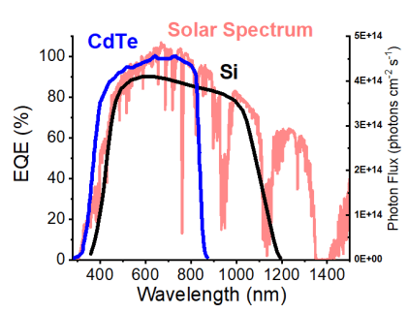
THESIS: IMPROVING EFFICIENCY OF SOLAR TECH AT THE MOLECULAR LEVEL
Solar Cell
ACS Appl. Energy Mater. 2020, 3, 19-28.
Notes:
So what does that mean in practice? What this means is that though light in the visible regime can be absorbed and converted to electricity, but IR and NIR light just transmits through the panel and does not get converted to electricity. Current solar tech is missing out on valuable IR light! So what can we do to get these panels to absorb more light?

Slide 28
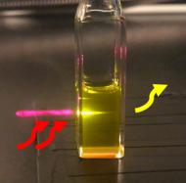
THESIS: IMPROVING EFFICIENCY OF SOLAR TECH AT THE MOLECULAR LEVEL
HARNESSING TRIPLET-TRIPLET ANNIHILATION UPCONVERSION FOR SOLAR ENERGY TECHNOLOGY
Solar Cell
UC Film
ACS Appl. Energy Mater. 2020, 3, 19-28.
Notes:
My research group harnesses the ability of triplet-triplet annihilation upconversion to convert low-energy light into high energy light. We can apply this to solar panels by absorbing the IR light not captured by semiconductors and then converting it into higher-energy light than can be absorbed by the semiconductor, thus increasing the amount of electrical output per area.

Slide 29
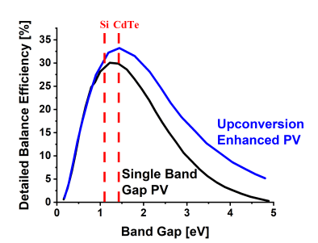
THESIS: IMPROVING EFFICIENCY OF SOLAR TECH AT THE MOLECULAR LEVEL
Solar Cell
UC Film
Sol. Energy Mater. Sol. Cells. 2008, 92(12), 1541-1546.
Notes:
Studies have predicted that upconversion-enhanced photocurrent generation can increase efficiency in Si-based solar panels by as much as 9 percent and in CdTe-based panels by as much as 18 percent!

Slide 30
THESIS: IMPROVING EFFICIENCY OF SOLAR TECH AT THE MOLECULAR LEVEL
CdTe
Solar Cell
UC Film
Notes:
Thus far, I have synthesized a new molecule shown here that absorbs light below the bandgap of CdTe, meaning it absorbs light CdTe cannot. This is a great first step, but the job is not done quite yet. Next I need to demonstrate that this molecule can transfer energy to an emitter molecule, which makes up the second part of the upconversion system. Ultimately, we want to make more molecules, each one absorbing light deeper into the IR region until we can absorb as much light as possible.

Slide 31
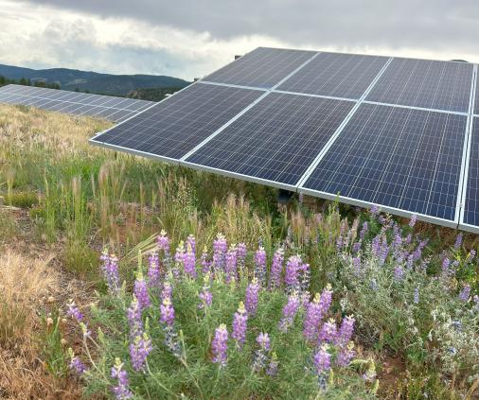
conclusions
Tribal solar energy is rapidly expanding—soon many tribes will have to figure out what to do with EOL panels
A hazardous waste expert should assess the damaged panels for leaching toxic metals prior to recycling or disposal
There are many solar panel recycling companies nationwide, but costs for services vary greatly
Though current methods of recycling panels are not fully sustainable, research into “greener” recycling processes are ongoing
Field visit to Picuris Pueblo

Slide 32
Thank you for listening!
Any questions?

